Slide 1
Creativity & Community
Engaging in Engagement at NASA
25 July 2019
Alana Cober, PhD
Office of the Chief Human Capital Officer

Slide 2




Today: NASA’s Civil Service Workforce At-A-Glance
17,347
Full Time Equivalent (FTE) Employees
17 Years
Average length of service at NASA
34%
of the
workforce is female
22%
Retirement Eligible Employees
48.4
Average age
career opportunities across science, technology, aeronautics and space exploration.
47%
7th Year Ranked Best Place to work (large agency)
of Civil Servants have a Master’s Degree or Ph.D.
68% Response Rate
Average annual
attrition
(FY2016-FY2018)
82% Engagement Index
5.5%
Distribution of
Employees by
Hiring Persona
83% Innovation Index
Early Career Hires
78% Inclusion index
In FY2016- FY2018, NASA had
669 hires (32% of all hires)
that were GS-11 and below
Total Workforce includes (10%)
1,688 Veterans
Data captured as of: February 2019. All percentages and fractions have been rounded.
Notes:
For context:
NASA is composed of 17,347 civil servants and roughly 33,500 contractors (including JPL).
Additionally, NASA is highly educated – over 47% of our employees have a Masters or PhD degrees
NASA is highly graded with nearly 90% of the workforce at GS-12 and above (85.8% actual)
Over 70% of our civil servant workforce falls into engineering, science, or technical disciplines
We have a highly experienced workforce, with the average age of our civil servants at 48.4 (including students)
Comparison of the Above Statistics Against Government-wide Averages (according to FEDSCOPE data from March 2018 and OPM data from Sept 2017)
Average length of service: 12.8 years (compared to 17 years at NASA)
Average Age: 47.5 (compared to 48.4 at NASA)
Gender: 43.7% female (compared to 34% female at NASA)
Education Level: 20.1% of federal civil servants have a Master’s Degree or higher (compared to 47% at NASA)
Annual Attrition: 9.5% annually across federal government and 18.5% for industry (compared to 5.5% at NASA)
Diversity:
White (non-minority) civil servant averages across government – 62.76% (compared to 71% at NASA)
African American - 18.15%; Hispanic or Latino - 5.99%; Asian or Native Hawaiian/Other Pacific Islander - 0.51%; Native American - 1.69%

Slide 3
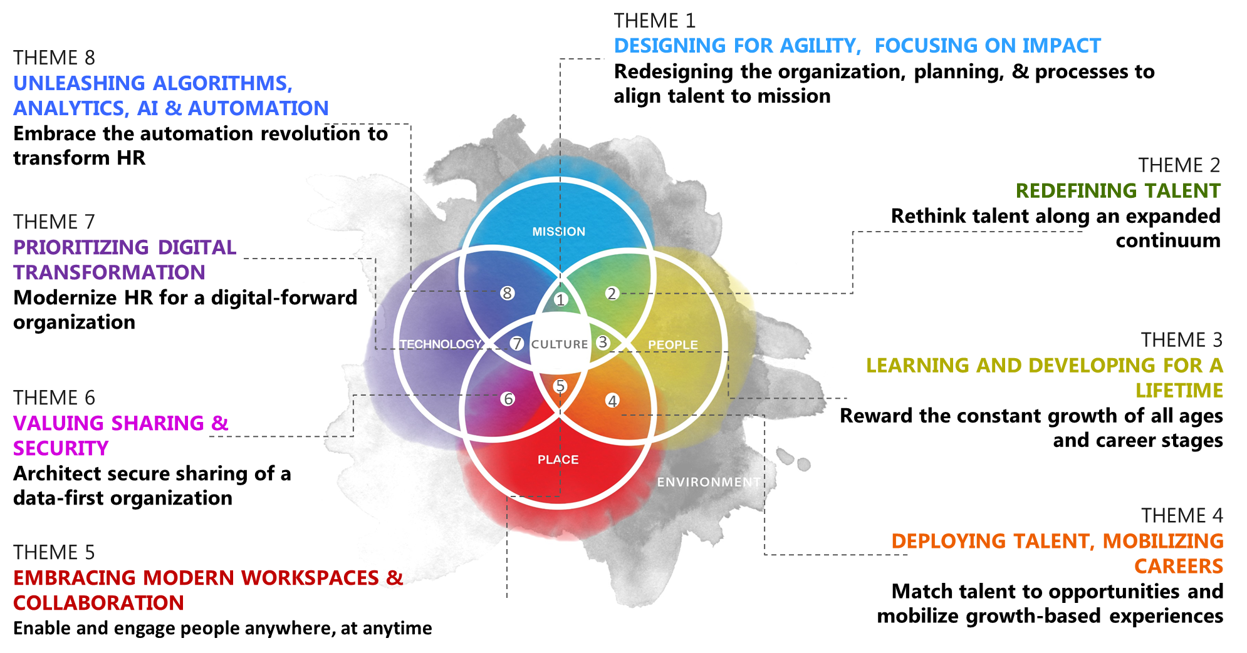
Tomorrow: NASA’s Future of Work Framework
Notes:
The Future of Work is already here, and we’re learning how to adapt to a changing industry and labor market. Our initial research points to a number of key themes among the intersections of mission, technology, people, the workplace, and ultimately, culture. Meanwhile, our Office of the Chief Human Capital Officer is underway with a major restructuring, along with all of NASA’s mission support offices, that transforms how we operate.

Slide 4

Leading through Change: Top Engagement Themes
NASA leaders at all levels serve as role models, develop their people and facilitate NASA's culture and operating environment
LEADERSHIP EXCELLENCE
NASA
ENGAGEMENT
NASA employees are key players in their careers and overall engagement to their work and the mission
EMPLOYEE INVOLVEMENT
NASA provides bold, open, frequent and multi-directional communications to keep employees “in the know”
SUPERIOR COMMUNICATIONS
  PRESERVE AND GROW THE NASA CULTURE AND BRAND AS A GREAT PLACE TO WORK
Employee Engagement: An employee’s sense of purpose that is evident in their display of
dedication, persistence and effort in their work or overall attachment to their organization and its mission. U.S. Office of Personnel Management
Notes:
What drives engagement at NASA? Our theory: people come to NASA to be a part of an inspirational mission, and then connect with each other and the work at the heart of that mission. In our 2017 and 2018 analysis, NASA identified three agency themes to foster employee engagement around that connection.

Slide 5
At the Core: Local Ownership of Engagement
Examples of innovations from a decentralized approach:
MSFC Implemented a formal awards program to address low scores on employee recognition; Led Build a Legacy, Leave a Legacy program for mentoring, inclusion & leadership
SSC Addressed career development concerns through an org restructuring; enhanced leadership & supervisory opportunities
Agency-wide Leadership Development Programs: FIRST, MLLP, LASER, 360° Environment Matters tool, SIP & Virtual Executive Summits
NASA
ENGAGEMENT
LEADERSHIP EXCELLENCE
JSC Implemented Innovation Days to enhance Innovation (FEVS) & Transparent Opportunities Program (TOP) stretch assignments for all
Langley GROW (Generating Rare Opportunities through Wisdom) mentoring to prepare employees for increased responsibility & Reverse Mentoring
Agency-wide FIRST designed & implemented the 1st AIM Day, Innovation Coins & Innovation Awards nominated & voted on by employees
EMPLOYEE INVOLVEMENT
ARC Focused on instilling open leadership communications through increased transparency in decision-making & multiple communication vehicles
AFRC We Are Armstrong day of sharing, team building, diversity & inclusion
Agency-wide Ask Me Anything Sessions provide employees with forum to ask senior leadership questions & voice concerns; Acting Administrator emails with updates on Administration transition, “state of NASA” news
SUPERIOR COMMUNICATIONS
Notes:
NASA encouraged our 10 Centers to address the key engagement themes, and innovations followed. [Call out several examples.] Agency-wide programs augment and complement decentralized creativity.

Slide 6
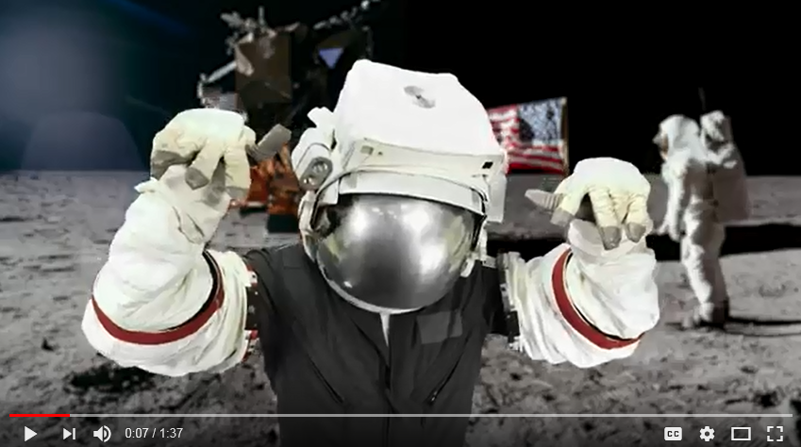
Connecting, not Directing, an OD/Analyst Community
Community in Practice ↔ Creative Connection
Community in Principle ↔ Intrinsic Motivation
The goal is not to improve survey scores.
The goal is to drive organizational improvement. Survey data is a proxy for employee perceptions and organizational health.
We help organizations identify blind spots and share successes.
Emphasis is on better understanding areas for improvement, as well as identifying, recognizing, and sharing what works well.
The process is as important as the actions.
Our Organizational Development experts engage organizations in working with, understanding and building action plans around the data.
Averages represent very little, and can obscure ground truth.
Looking for variation among segments and multi-year trends for gains and losses over time are meaningful starting points for exploring the data.
Survey data should be examined in context with other metrics.
Even where correlation or causation are not demonstrable, context adds perspective.
Survey results are the start of the conversation, not the end of it.
Transparency is critical in sharing survey results; understanding and actionability are critical for sharing relevant survey results.
First of KSC’s 2019 FEVS Marketing Series
https://www.youtube.com/watch?v=GDudwyOACBY&feature=youtu.be
Notes:
To foster learning, collaboration, scalability, and healthy competition, NASA connects each center’s organizational development professionals and analysts through a community co-chaired by the Chief Learning Officer and People Analytics Director. This group informs agency strategy, implements any agency guidance, and most importantly connects with each other for collaborative support. Principles like the ones listed here are not top-down, they’re driven by the community. And while outcomes of this decentralized approach, like this marketing video, can be … unique … they express the culture and creativity of the Centers more than any corporate program could.

Slide 7





Looking Ahead: Engagement & Data-Driven Strategy
New Strategies Underway Across the FEVS and Engagement “Cycle”
Understand
Analyze in Context
Plan
Focus on Actions
Support
Enable Success
Execute
Hold Accountable
Measure
Gather Data
New Analytic capabilities for data integration, visualization, exploration, and dissemination
Partnering with new HRBP role moving toward integrated strategy, services, & operations
Expanded integration across HR, Diversity & Inclusion, Internal Communications
Broader communication of results and actions, with wider
recognition of successes
New additional instruments for listening to workforce perceptions and priorities
Notes:
While NASA OCHCO continues transforming – in an environment with ever-increasing requirements and decreasing resources – we’re continue to adapt how we approach FEVS and engagement in context. A year from now this may look different as we rebuild our talent strategy, operating model, and IT architecture. But we know this is too important to wait, and the more we envision the future, the more we can build a solid foundation for strategy and execution. We’re see the amazing innovation and execution underway across agencies and are always interested in learning from others as we shape this future, so please feel free to reach out. We’re very appreciative of the leadership several agencies have taken in strengthening the government community of FEVS and engagement leaders, and OPM’s leadership in evolving the program.

